Slide 1
Final Presentation
By Team [Hip, Hip]: Jack, Alea, and Elizabeth

Slide 2
Abstract
Team overview
Details of sprint reviews
Demo
Concluding thoughts
We will be going over…

Slide 3
Team Members & Roles
Jack Parcell – Scrum Master, Front End, Back End, and everything in between
Elizabeth Dixon – Front End and Quality Assurance
Alea Alvi – Database Design

Slide 4
Insurance Claim Management System
System designed to facilitate and manage transfer of insurance details
Web-based application (windows form)
Four User Types: Client, Administrator, Claim Manager, Finance Manager
Decision-making
Seamless flow
Started with:
SQL Database
Basic security precautions
Notes:
The project we selected was the Insurance Claim Management System. It is designed to cover a wide range of insurance company and management processes. The system supports effective decision making for clients, administrators and accounting. It does this by providing relevant information such as claims, valuations, and messages to those who need them. The four user types are Client, Administrator, Claim Manager and Finance Manager. The Client is someone who files an insurance claim and uploads any relevant documents. The Claim Manager views those claims, approves or denies them, and then keeps the client updated. The finance manager views the approved claims, provides an amount to be paid out, and does so. The Administrator creates user accounts, manages permissions, and runs reports.

Slide 5
Sprint #0
Choose the project
Assign roles
Brainstorm ideas for the layout
Plan User Stories
As a client, I want to be able to apply for a claim
As a claim manager, I want access details to help guide client
As a finance manager, I want to be able to estimate amounts
As an admin, I want to be able to grant privilege and oversee user details
Notes:
The main goal of Sprint 0 was to choose the project that we would like to work on, assign roles, and begin thinking about the best ways to complete our project. A Trello board was utilized to keep track of our progress, and a GitHub repository was created. User stories for our selected project were also created.

Slide 6
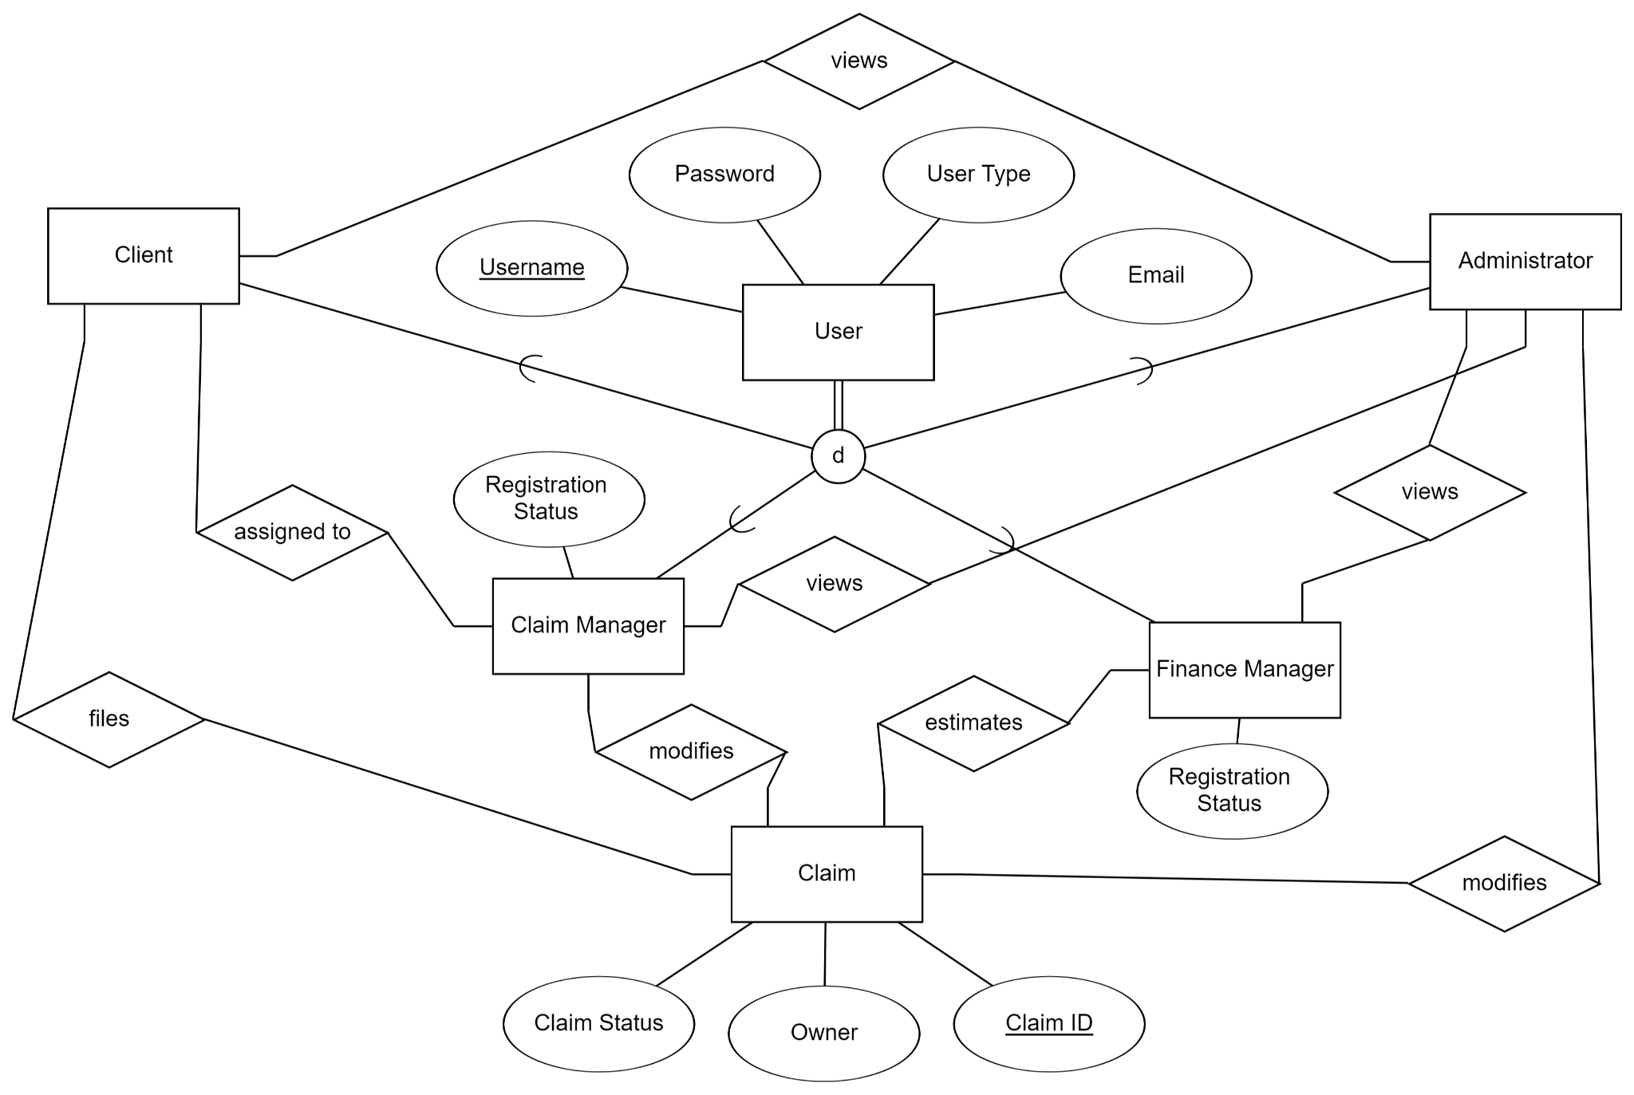
Sprint #1
Focused on client
Front-end design
Overall style
Form transitions
SQL server setup
ERD design
Version control issues
Notes:
JACK
The main goal of Sprint 1 was to get a good start to the project so that we would have momentum for the rest of the semester. Much of the work focused on the frontend design of the project. The Homepage was created, along with pages that allowed a user to file a claim, view their claims and view their profile were all created. An Azure SQL server was also created to allow us to save Claims, Users, Messages, etc. After the SQL server was created, Alea got to work on creating the initial ERD. The User entity was created as a supertype, with CLient, Claim Manager, Finance Manager, and Administrator tables all created. Connected all of these tables resulted in a very complicated ERD, but we were able to use it as a guide to begin work. Finally, The team dealt with some teething issues related to GitHub, but they were quickly ironed out.

Slide 7
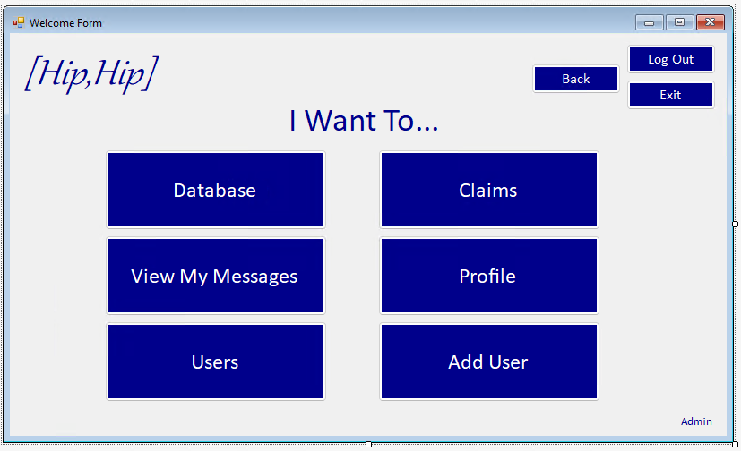
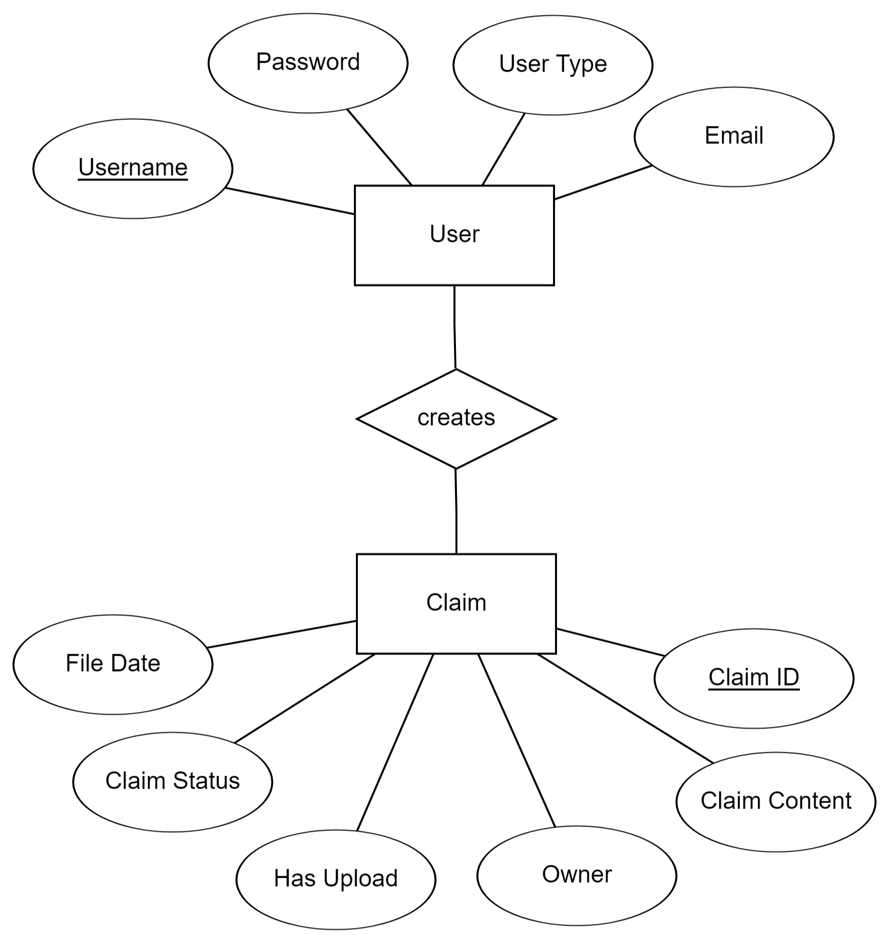
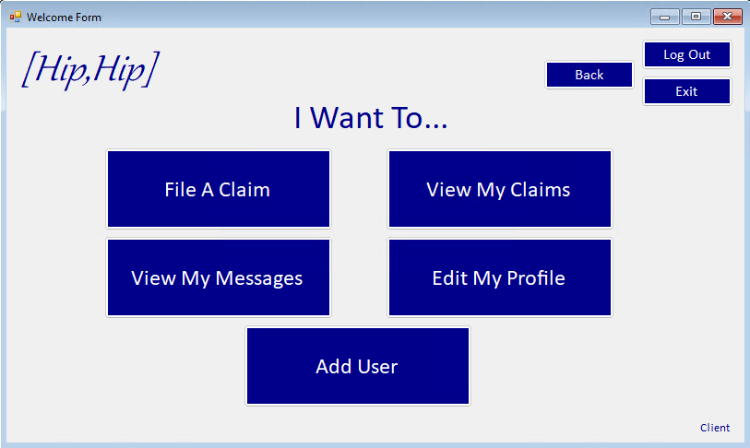
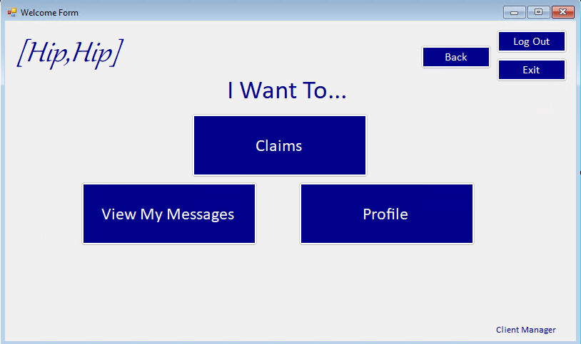
Sprint #2
Simplified ERD
Different homepages
Backend development
Frontend polishing
Functional Login page
Notes:
JACK
Sprint 2 brought with it a large amount of progress on the project. Our plan was to allow the user to login and create a claim. To make project workflow more seamless, the ERD was simplified, with the understanding that it would later be revised. Different homepages for different types of users were also created. A large amount of work went to implementing backend development. My work now allowed for a client to login, and be able to file a claim, while Administrators were also given the ability to create a user. Both the claim and the new user would then be uploaded to the database. On the frontend side of things,

Slide 8
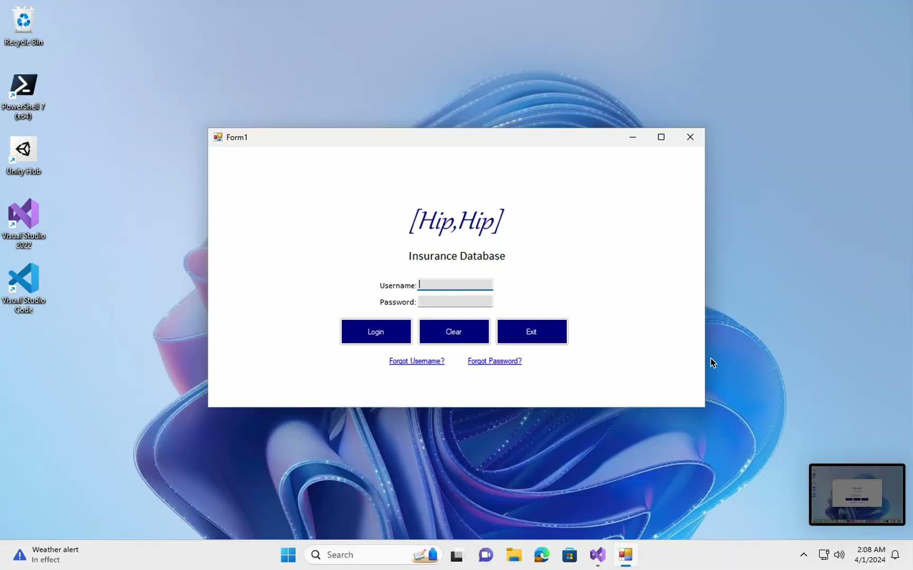
Sprint #3
Scrum Master withdraw
Updated ERD
Automatically generate unique IDs
User class implementation
Viewing data from DB
Not the greatest formatting
Forgot password
Notes:
JACK
Sprint 3 came with some unfortunate team news. A team member withdrew from the class, leaving us one team member short. Despite this setback, we continued with our previous velocity. My main goal for this sprint was to polish some of the work that I did in the previous sprint, while also continuing to add further functionality. To do this, I created an updated ERD because I noticed that the existing simplified ERD was no longer cutting it as I was adding functionality. The Submit Claim and Create User functionalities were improved, with the Claim/User Number now being automatically generated. In addition, a User’s user type was retrieved when they logged in. With this addition, different homepages were displayed while buttons were hidden or shown as needed. Functionality was added to allow users to view claims in the database, with clients limited to viewing just their claims while managers were able to view all claims. Finally, a forgot password function was generated, which now allowed the user to click “Forgot My Password” on the login screen and be sent an automatically generated email with their new password.
Jump IN

Slide 9
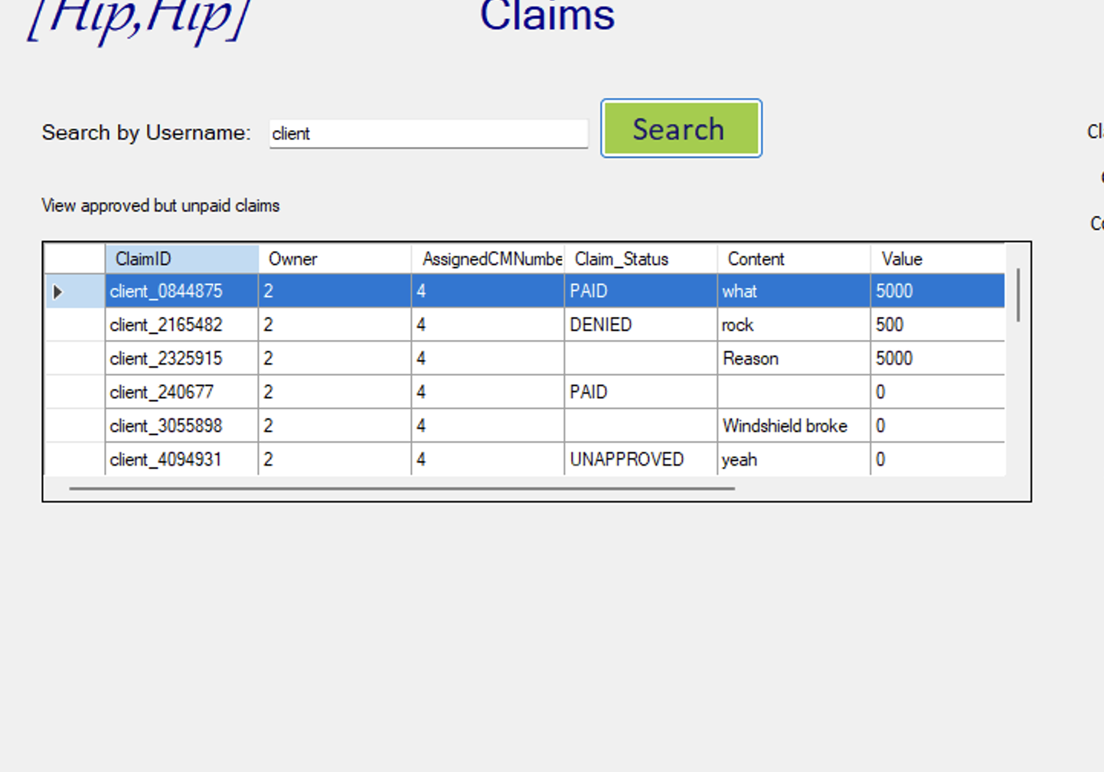
Sprint #4
Finance and Claim Managers can do their jobs
Can now send/view messages
DataGridView implementation
PDF downloading
User experience improvement
Notes:
JACK
Sprint 4’s progress greatly improved functionality across the board. We really wanted to allow the managers to be able to “do their jobs.” We added the functionality so that Finance and Claim managers were now able to view claims, and perform actions on them such as Approve, Deny and Pay. The Messaging functionality was also implemented, giving users the ability to send messages to each other. A further goal of this sprint was to clean up how data is displayed, and that was done using the DataGridView Class in C#. With this class, a user could also download the table to their computer in a PDF format. Our project was nearing completion, with just a few more items requiring some TLC

Slide 10
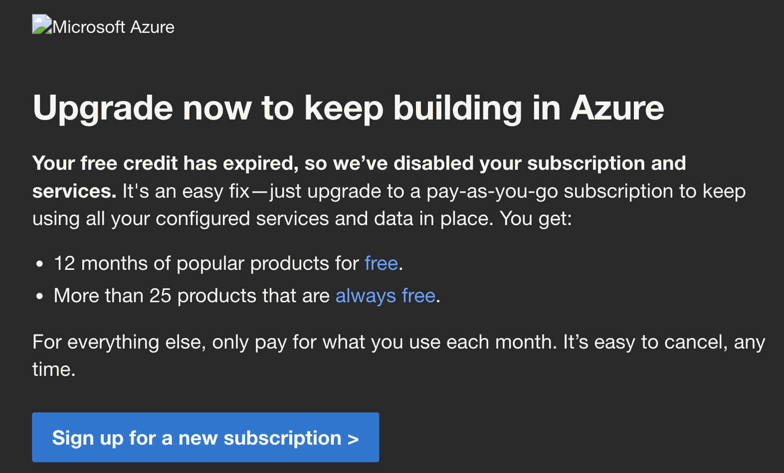
Sprint #5
Work grinds to a halt
PDF uploads
Quality of Life Improvements
Try catches everywhere applicable
User Story finishing touches and consistency
See user details as needed
Validate and transfer
Finance Manager → Client
Claim Manager → Finance Manager
File view
Notes:
The major user story that our project was missing was the ability of a user to upload a supplemental file to their claim. Obviously, getting this finished was our main priority heading into sprint 5 as this is one of the main functionalities of the interactions between each user. Once this feature was implemented, our focus shifted to improving user experience with these claim interactions as they were implemented. While all of our user stories were completed, there were ways that we could make the overall user experience better and more optimized → try catches that would help the users know what to do in the event of an error. Certain users needed to see others’ details (via profile form), and validation and transfer was made consistent across the board so FM -> C, CM -> FM; file view.

Slide 11
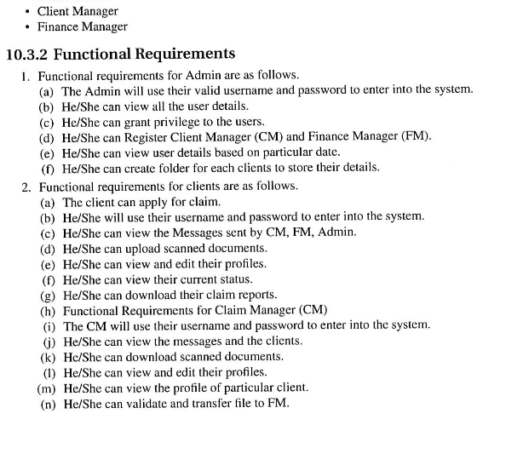
Claim Manager? Client Manager? Who Knows!
Notes:
While I was working on the final report, I noticed that the Project Description used Client Manager in certain places. This obviously concerned me, because I have been using Claim manager the entire semester. It wasn’t until I continued reading the project description that I realized the error was not mine, but of the authors. On the same page, they use client manager and claim manager interchangeably.
JACK

Slide 12
Demo

Slide 13
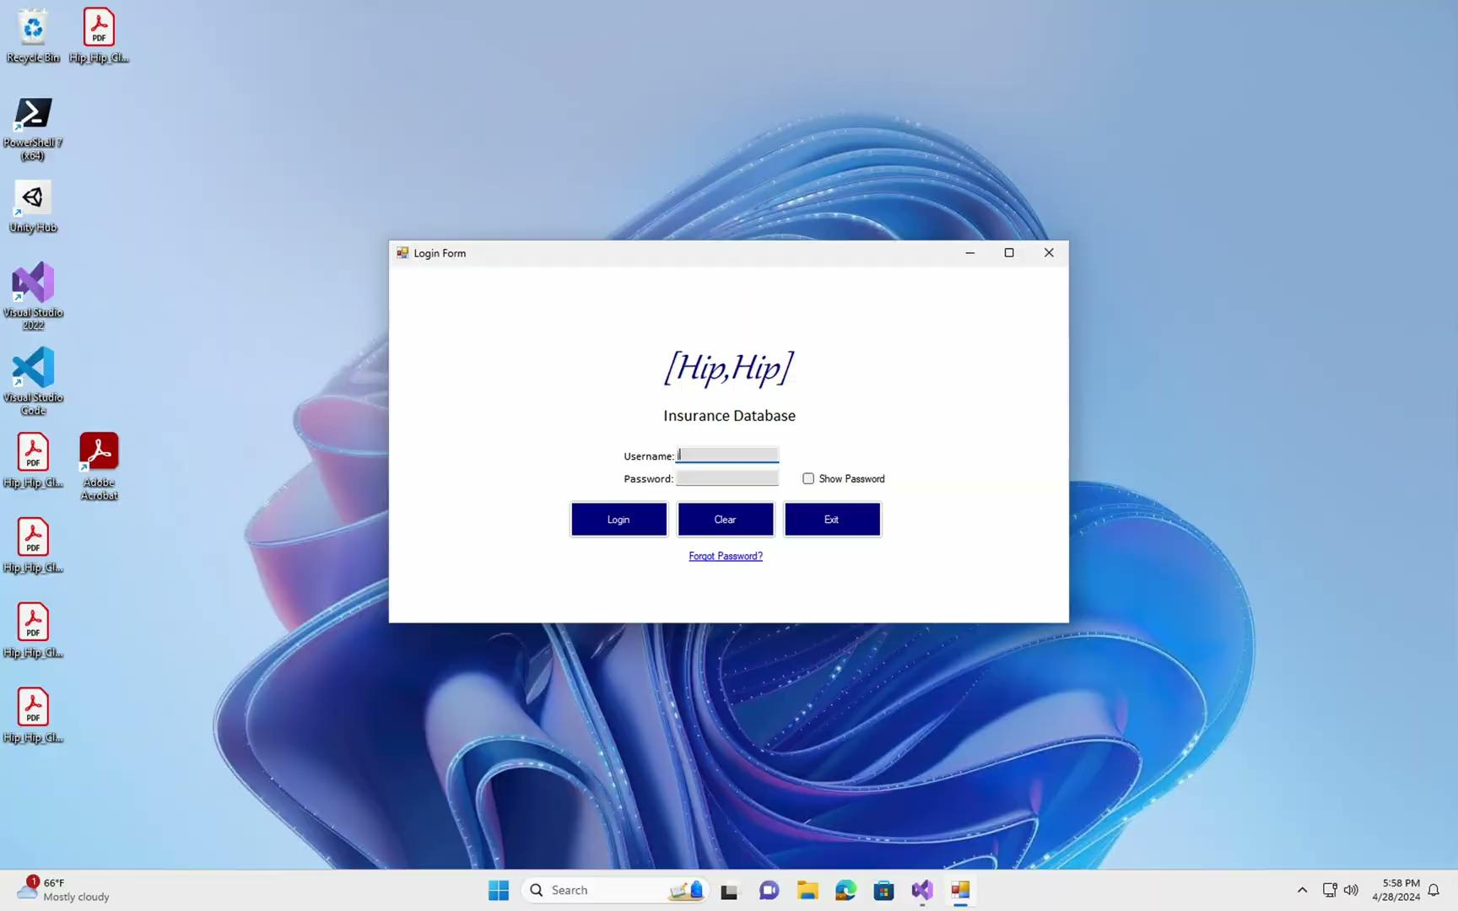
Administrator

Slide 14

Client

Slide 15

Claim Manager

Slide 16

Finance Manager

Slide 17
Concluding Thoughts
Did we actually learn Scrum?
What did we think of it?
What would we do differently?
How did everything go?
Notes:
Finally, some concluding thoughts regarding the process of our project. _______? Using the scrum methodology was very beneficial for us - it help us keep ourselves in check so that we could consistently and quickly create demo-able products to present in our sprint reviews. Because of that, we really enjoyed using scrum - sometimes it’s easy to forget how beneficial it is to be consistent. Of course, our process wasn’t perfect, so one thing that would’ve been helpful would have been to consistently use the Trello board - the to do, currently doing, and done visual would have been helpful to further optimize our process. In general, despite our obstacles, we feel that our project went really well - it was fun, and in the end we were able to produce something usable and user-friendly.

Slide 18
Thank you!

Slide 19
